Slide 1
[mode] mode share trends, [division/state], 2010-2023
Insert chart copied from Exercise #1 Excel dashboard
Summarize the commuting trends over the past decade for your selected place and mode. What changes and trends do you see in mode share over this period? How does this compare with national trends? What factors do you feel may help explain this trend?
Data sources: US Census Bureau TIGER/Line; ACS 5-Year Estimates B08301.

Slide 2
[mode] mode share trends, [division/state], 2010-2023
Insert chart copied from Exercise #1 Excel dashboard
Summarize the commuting trends over the past decade for your selected place and mode. What changes and trends do you see in mode share over this period? How does this compare with national trends? What factors do you feel may help explain this trend?
Data sources: US Census Bureau TIGER/Line; ACS 5-Year Estimates B08301.

Slide 3
TOP ten counties in [MODE] mode sharE, 2023
County Name | State | Division | Mode Share
Which counties have the greatest share of the selected transportation mode? Why do you feel these counties may have a higher share of the selected mode?
Data sources: US Census Bureau TIGER/Line; ACS 5-Year Estimates B08301.

Slide 4
TOP ten counties in [MODE] mode sharE, 2023
County Name | State | Division | Mode Share
Which counties have the greatest share of the selected transportation mode? Why do you feel these counties may have a higher share of the selected mode?
Data sources: US Census Bureau TIGER/Line; ACS 5-Year Estimates B08301.

Slide 5
Map of [mode] mode share by us county, 2023
Insert map downloaded from exercise web page
Which divisions and states appear to have the greatest share of the selected transportation mode? What factors do you feel may help explain this pattern?
Data sources: US Census Bureau TIGER/Line; ACS 5-Year Estimates B08301.

Slide 6
Map of [mode] mode share by us county, 2023
Insert map downloaded from exercise web page
Which divisions and states appear to have the greatest share of the selected transportation mode? What factors do you feel may help explain this pattern?
Data sources: US Census Bureau TIGER/Line; ACS 5-Year Estimates B08301.

Slide 7

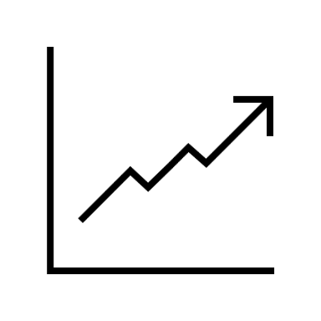

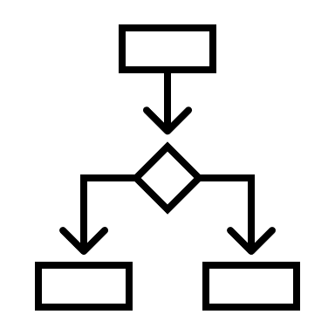


Use slide 8 to create an annotated mockup of a sustainable urban transportation data dashboard. (Use icons to represent particular types of data.)
What dimension(s) of sustainable urban transportation would you like the dashboard to inform?
What types of indicators, data, or other information would you include on the dashboard to inform this(/these) dimension(s)?
Who (i.e., what constituencies and stakeholders?) do you think would benefit from using the dashboard (e.g., community-based organizations, federal agencies, commuters)?
How could these constituencies or stakeholders use the information on the dashboard?

Slide 8
IMPROVING BIKE MODE SHARE IN CHICAGO
Bike trips over time
Map of Bike Trips

